Slide 1
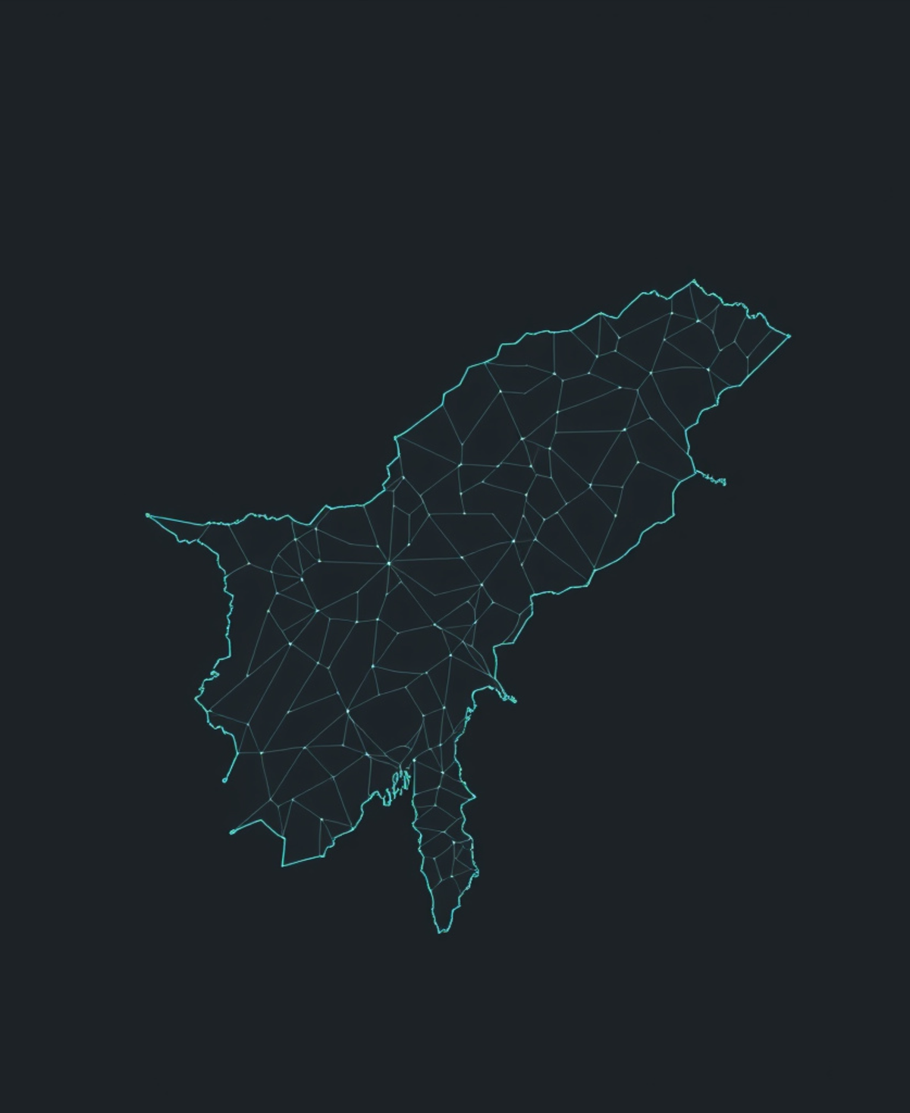

ACADEMIC RESEARCH PROJECT
Maharashtra Through Official Data
A structured analysis of public reports, timelines, and regional evidence.
UNIVERSITY VIVA PRESENTATION
Data storytelling · evidence-led inquiry
EVIDENCE / STRUCTURE / CONTEXT

Slide 2


RESEARCH DESIGN / 01
Project Question
From an open research concern to a question precise enough to investigate.
ACADEMIC FRAMING
RESEARCH-QUESTION PROTOTYPE
RQ / 01
A question is a method boundary.
Central question
How can official data be structured into evidence that clarifies the problem — and supports a credible response?
It defines what counts as evidence, what remains outside scope, and how the analysis will be judged.
QUESTION ARCHITECTURE
01Problem
02Evidence
Scope
Source → structure → interpretation
03Response

Slide 3



METHOD / RESEARCH JOURNEY
Study Framework
From official surveillance records to interpretable seasonal insight.
01
02
03
Data Intake
Structure the Signal
Read the Pattern
Government surveillance data forms the empirical foundation of the study.
Cleaning and classification convert raw reports into a consistent analytical dataset.
Temporal analysis leads into seasonal interpretation and research insight.
Official records
Repeatable pipeline
Time-aware interpretation

Slide 4





METHOD · DATA PROVENANCE
Data Source
Official surveillance inputs are preserved as a transparent path from source to analysis.
01 · SOURCE ARCHITECTURE
02 · ANALYSIS PATHWAY
Official surveillance inputs
Source → dataset → analysis
Each official input is carried forward into a structured dataset before interpretation.
The architecture begins with NCDC and IDSP records, grounding the study in official public-health reporting.
INPUT
STRUCTURE
OUTPUT
NCDC + IDSP
Dataset
Analysis
Weekly outbreak surveillance
A recurring reporting context, not a fabricated count.
Scope note: this slide describes provenance only — no statistics or counts are introduced.

Slide 5



Study area
Study Area — Maharashtra
A clean geographic frame for district-level analysis and focused surveillance interpretation.
SCOPE OF ANALYSIS
Geographic frame
MAHARASHTRA
From state outline
to district insight.
District-level potential
The state frame supports finer geographic comparison.
Analytical highlights only
Selected zones signal where analysis can be concentrated.
No district disease values are shown on this study-area view.
Highlight zones indicate analytical focus — not disease values

Slide 6


PROTOTYPE SCHEMA / 01
Data Structure
A clean foundation for organizing surveillance records before analysis.
MOCK DATASET PREVIEW
SAMPLE — NOT FINAL RESEARCH DATA
SCHEMA LOGIC
One record, one structured story
Each row connects place, time, disease, and impact.
YEARWEEKDISTRICTDISEASECASESDEATHS
2024W14PuneDengue——
01
Time
2024W15NashikChikungunya——
Year and epidemiological week
02
Place
2024W16NagpurMalaria——
District-level reporting unit
03
Impact
Cases and deaths, when available
Outbreak start date can be appended as the event anchor.
Template view only · values intentionally withheld

Slide 7

METHOD · DATA PREPARATION
Data Cleaning
Turning report artifacts into a defensible analytical dataset.
01 · SOURCE MATERIAL
02 · ANALYTICAL STRUCTURE
Raw reports
Clean dataset
Useful evidence, but not yet analysis-ready.
Validated, standardized, and ready for interpretation.
AExtract fields from official report artifacts
✓Validate extracted values against source reports
BIdentify inconsistent labels, dates, and gaps
✓Standardize labels and date formats
✓Document illustrative missing-value handling
Scattered structure · variable language · missing context
Traceable transformations · consistent fields · analysis-ready

Slide 8
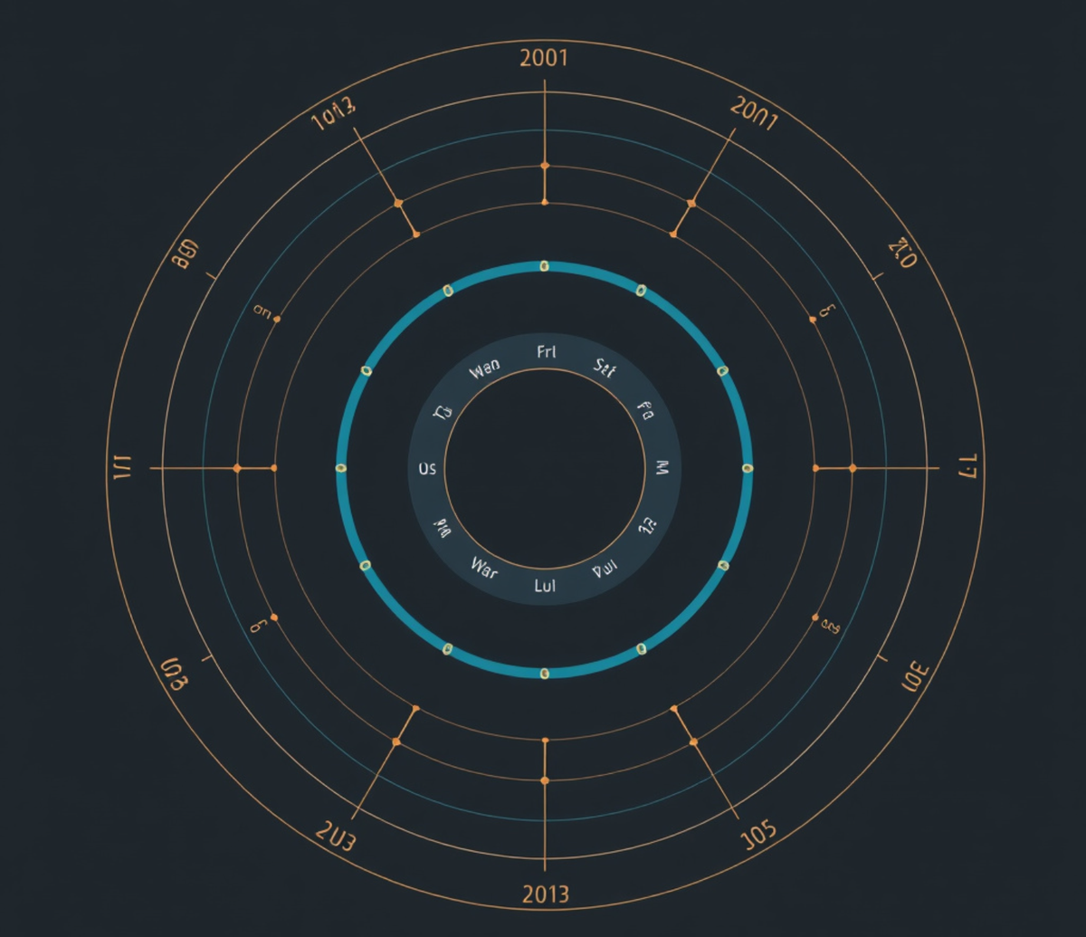


SEASONALITY CONCEPT
Time becomes pattern.
A conceptual framework for reading recurring change — not a findings slide.
“The unit of analysis shifts from a single week to the rhythm of a season.”
Map the cadence
before interpreting it.
Week → month → season
A consistent scale for organizing time.
Pattern logic over time
Observe recurrence before drawing conclusions.
FRAMEWORK VIEW
Conceptual only
not a result
From interval to cycle

Slide 9



Temporal analysis template
Weekly trend, ready for final values
A clean time-series frame for showing movement, comparison, and reporting cadence.
Placeholder weekly trend
Weekly series
Template status
Final observations will replace the open series.
FINAL VALUES
PENDING
Weekly cadence
Chart language
Axes establish the reporting window; the legend names the measure.
Designed for a clear read before interpretation begins.

Slide 10



ANALYTICAL TEMPLATE / MONTHLY VIEW
JAN — DEC
Monthly Pattern Template
A neutral month-by-month frame for inserting an approved series.
Monthly distribution
AREA / BAR OPTION
BUILD NOTES
Template axis only · values intentionally omitted
Use one consistent monthly measure.
Choose area or bars after review.
Annotate only validated patterns.
SOURCE STATUS
Awaiting series input
Minimal gridlines keep the comparison readable. NO IMPLIED REAL VALUES

Slide 11




ANALYTICAL TEMPLATE / 01
Disease Comparison Template
A modular language for comparing three illustrative disease series.
PRIMARY VISUAL
ILLUSTRATIVE ONLY
Disease A
Multi-series chart zone
Series identity and source label
BLUE / PRIMARY SERIES
Disease B
Series identity and source label
Insert aligned time-series chart
Use shared axes, consistent units, and the legend at right.
TEAL / COMPARISON SERIES
Disease C
Series identity and source label
LEGEND SYSTEM
Disease A Disease B Disease C
AMBER / EMPHASIS SERIES

Slide 12





01 / ANALYTICAL PROTOTYPE
MAHARASHTRA / SAMPLE VIEW
District-Level Template
A repeatable visual framework for comparing Maharashtra districts.
PROTOTYPE MAP
Fictional / sample values only
VALUE INTENSITY
Lower signal
Mid-range signal
Higher signal
District comparison framework
Interpretation guardrail
Same boundary logic, indicator set, and legend across every district.
Use this visual to test structure—not to claim observed outcomes.

Slide 13



Research synthesis
Key findings
Three evidence-led takeaways organize the final interpretation.
01
02
03
Evidence pattern
Interpretive insight
Practical implication
Summarize the clearest pattern emerging from the source material.
State what the evidence means for the central research question.
Translate the finding into its consequence for practice, policy, or future study.
→ Anchor the finding in observed evidence
→ Connect the pattern to the argument
→ Close with the next decision or action

Slide 14




METHOD NOTE / 06
Limitations
Interpret the signal as reported surveillance—not a complete measure of disease burden.
What the dataset captures
Where uncertainty enters
The evidence base reflects how events were reported and documented.
The analytical pipeline introduces interpretive decisions before comparison.
Reported outbreaks, not total incidence
OCR and extraction uncertainty
Unreported or undetected events remain outside the observed signal.
Digitization can alter dates, locations, or disease terms.
Source-week completeness may vary
Disease-label standardization required
Gaps in reporting can shape apparent timing and volume.
Terminology must be harmonized before meaningful synthesis.
READ AS: documented activity, not prevalence
READ AS: a structured estimate with caveats

Slide 15



RECOMMENDATIONS / ACTION FRAMEWORK
Recommendations Template
Translate the analysis into clear, accountable next steps.
01
02
03
Define the priority
Assign ownership
Specify the next move
Focus attention on the most consequential finding.
Name the institution or team responsible for action.
Convert the recommendation into a practical policy step.

Slide 16


CLOSING NOTE
Thank you
Questions and discussion
SEASONAL LENS
Winter Spring Monsoon Autumn

Slide 17




Visual language
Design System
A reusable visual language for clear, credible, data-led presentation updates.
01 / FOUNDATION
02 / EVIDENCE
03 / SYSTEM
Palette & hierarchy
Chart, card & map rules
Spacing & grid principles
Warm off-white surfaces, charcoal anchors, and restrained blue-teal accents establish academic credibility.
Minimal charts, modular cards, and simple Maharashtra silhouettes keep analysis legible.
A disciplined 12-column grid, generous whitespace, and repeatable templates protect alignment.
Reusable template language
Every future slide should feel related, intentional, and ready for evidence.

